Slide 1
Empowering Our Elders: The Community Development Project
By: Prajot Nikam.
Registration No: 12300525.
A Journey Towards Enhanced Elderly Care and Support

Slide 2
01
Introduction to the Project
Table of Contents
02
Identifying the Need for Elderly Care
03
Project Goals and Objectives
04
Steps Taken for Successful Implementation
05
Measuring Project Effectiveness and Conclusion
06 - 07
Geo-tagged pictures from NGO
08
Certificate from NGO

Slide 3
1
Introduction to the Project
Non-governmental organizations (NGOs) are key players in fostering positive societal changes and nurturing vulnerable communities. The Jalhari Shabnak Foundation, initiated in 2017, exemplifies how passion and commitment can drive impactful change. Founded by Mr. Rajesh Gadkari and Miss Pratibha Gurav, this NGO focuses on providing essential services to senior citizens. Through shelter, food, and medical assistance, the foundation addresses the pressing needs of the elderly in Khapargade, Tehsil- khanapur, Dist-Sangli, Maharashtra. Their self-funded approach ensures transparency and effectiveness in addressing societal challenges.

Slide 4
2
Identifying the Need for Elderly Care
As societies progress, the care for the elderly often takes a backseat, leading to neglect and unaddressed needs. The increasing number of senior citizens necessitates dedicated initiatives to improve their lives. This project acknowledges the gap in elderly care services and seeks to bridge it through direct support and action. By focusing on the elderly, we address a crucial societal issue and enhance community welfare. Recognizing these needs is the first step towards meaningful development.

Slide 5
3
Project Goals and Objectives
The primary objective is to enhance the quality of life for the elderly through comprehensive care and support. This includes providing shelter, medical assistance, and a nurturing environment. Education and awareness campaigns aim to engage the community in supporting elderly care. Strengthening social ties and encouraging volunteer participation will empower local efforts. Ultimately, the goal is to create an inclusive community where the elderly feel valued and cared for.

Slide 6
4
Steps Taken for Successful Implementation
The project launched with community engagement, identifying the specific needs of the elderly population. Collaborations with local health professionals ensured proper medical care and support. Regular workshops and outreach programs were conducted to raise awareness about elderly care. Geo-tagged pictures documented the progress and effectiveness of initiatives undertaken. Continuous assessment and feedback loops helped refine the project for better outcomes.

Slide 7
5
Measuring Project Effectiveness and Conclusion
The project's effectiveness lies in its direct impact on the elderly and community awareness on their needs. Feedback from beneficiaries highlights improvements in their quality of life and social engagement. Two main societal problems identified include lack of awareness about elderly care and insufficient resources. Through this project, we’ve paved the way for ongoing support and better understanding of elderly needs. Thank you for your attention; together, we can create a caring future for our seniors.

Slide 8
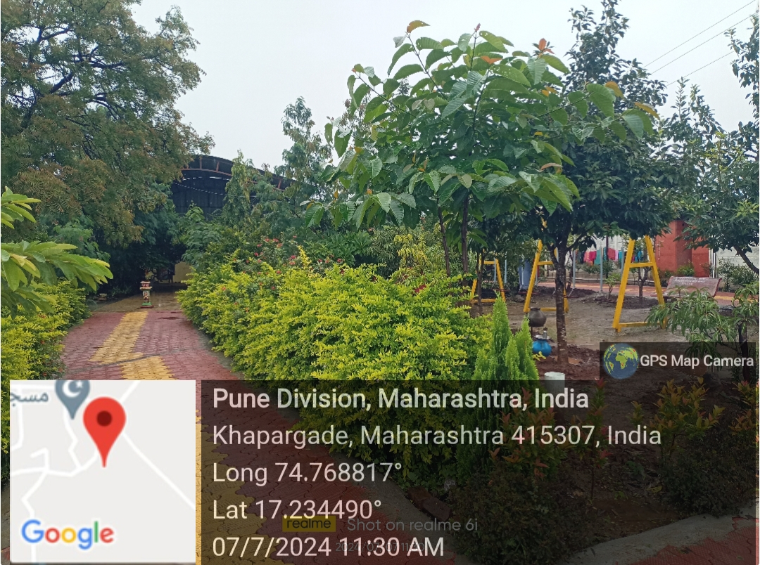
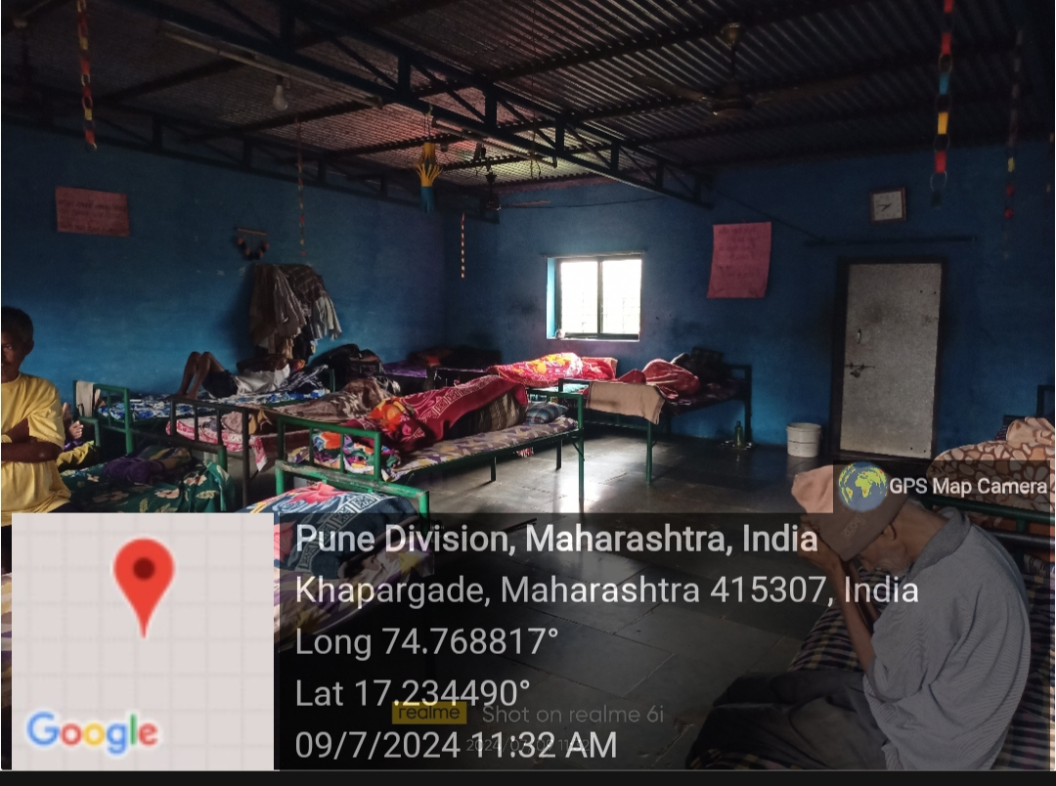
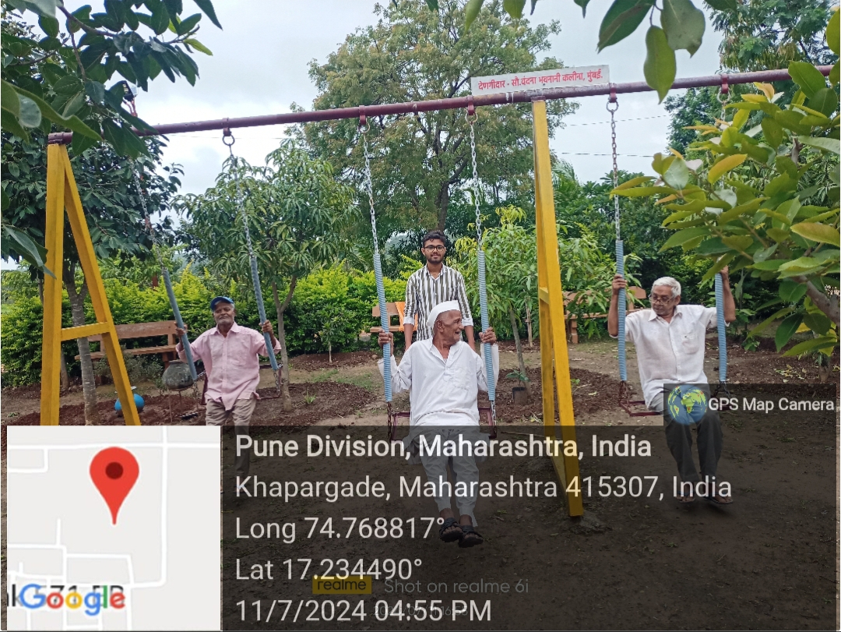
6
Geo-tagged pictures from NGO

Slide 9
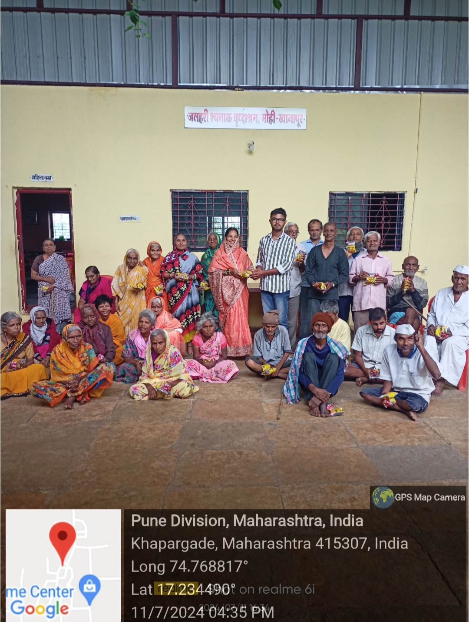
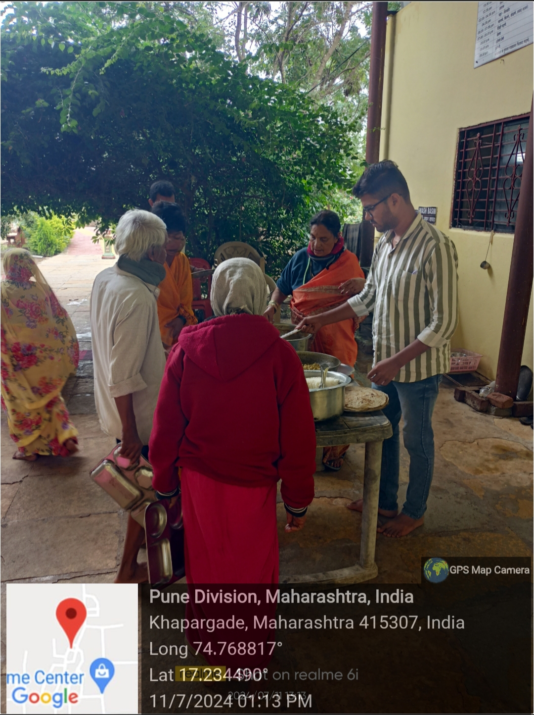
7
Geo-tagged pictures from NGO

Slide 10
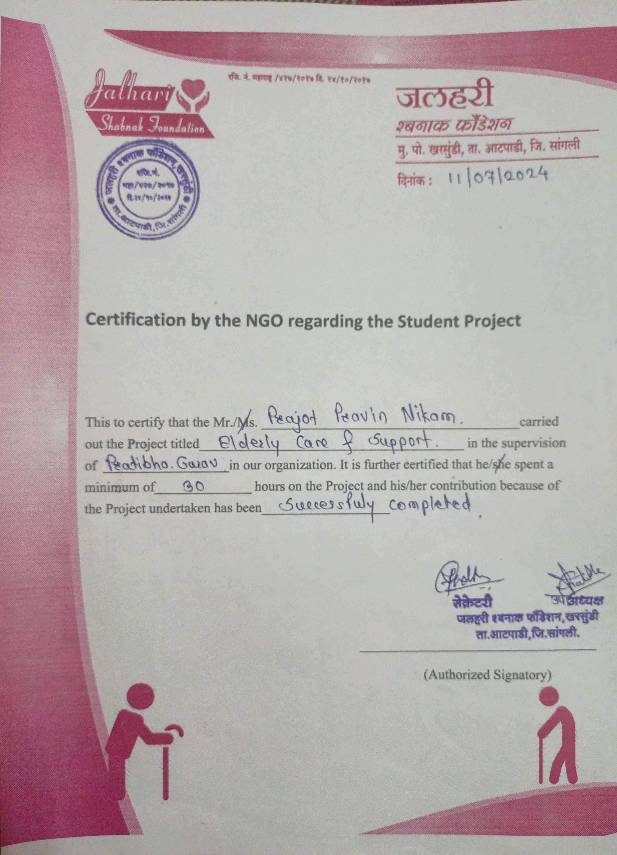
8
Certificate by NGO

